Slide 1

Typhoid fever

Slide 2
Typhoid fever is the result of systemic infection mainly by S. typhi found only in man.
The disease is clinically characterized
Typical continuous fever for 3 to 4 weeks,
Relative bradycardia with involvement of lymphoid tissues
Considerable constitutional symptoms.
The term “enteric fever” includes both typhoid and paratyphoid fevers.
The disease may occur sporadically, epidemically or endemically.

Slide 3
Agent
S. typhi is the major cause of enteric fever.
S. para A and S. para B are relatively infrequent.
S. typhi has three main antigens - O, H and Vi and a number of phage types (at least 80).
Phage typing has proved a useful epidemiological tool in tracing the source of epidemics.
S. typhi survives intracellularly in the tissues of various organs.
It is readily killed by drying, pasteurization, and common disinfectants.
The factors which influence the onset of typhoid fever in man are the infecting dose and virulence of the organism.

Slide 4
Reservoir
(i) CASES : The case may be mild, missed or severe. A case (or carrier) is infectious as long as bacilli appear in stools or urine,
(ii) CARRIERS : The carriers may be temporary (incubatory, convalescent) or chronic.
Convalescent carriers excrete the bacilli for 6 to 8 weeks, after which their numbers diminish rapidly.
By the end of three months, not more than 4 per cent of cases are still excreting the organisms; and by the end of one year, the average carrier rate is around 3 per cent,
Persons who excrete the bacilli for more than a year after a clinical attack are called chronic carriers. In most chronic carriers, the organisms persist in the gall bladder and in the biliary tract.
A chronic carrier state may be expected to develop in 2 to 5 per cent of cases.
A chronic carrier may excrete the bacilli for several years (may be as long as 50 years) either continuously or intermittently. The famous case of “Typhoid Mary” who gave rise to more than 1300 cases in her life time is a good example of a chronic carrier.
Faecal carriers are more frequent than urinary carriers. Chronic urinary carrier state is often associated with some abnormality of the urinary tract.

Slide 5
Source of infection
The primary sources of infection are faeces and urine of cases or carriers;
The secondary sources contaminated water, food, fingers and flies.
There is no evidence that typhoid bacilli are excreted in sputum or milk.

Slide 6
Host factors
Age : Typhoid fever-may occur at any age.
Highest incidence of this disease occurs in the 5-19 years of age group.
In some of these areas, pre-school-age children less than 5 years show incidence rates similar to those of school-age children.
After the age of 20 years the incidence falls probably due to acquisition of immunity from clinical or subclinical infection
Sex :
More cases are reported among males than females, probably as a result of increased exposure to infection.
But carrier rate is more in females,
Immunity-
Antibody to the somatic antigen (O) is usually higher in the patient with the disease, and the antibody to the flagellar antigen(H) is usually higher in immunized individuals.
Serum antibodies are not the primary defences against infection; S. typhi being an intracellular organism, cell-mediated immunity plays a major role in combating the infection.
Natural typhoid fever does not always confer solid Immunity.
Among the host factors that contribute to resistance to S. typhi are gastric acidity and local intestinal immunity.

Slide 7
Environmental factors
Peaks in rainy season (July to September)
Typhoid bacilli do not multiply in water; many of them perish within 48 hours, but some may survive for about 7 days.
They may survive for over a month in ice and ice-cream.
They may survive for up to 70 days in soil irrigated with sewage under moist winter conditions, and for half that period under drier summer conditions
Typhoid bacilli grow rapidly in milk without altering its taste or appearance in anyway.
Compounded by such social factors as pollution of drinking water supplies, open air defecation and urination, low standards of food and personal hygiene and health ignorance.
Typhoid fever may therefore be regarded as an index of general sanitation in any country.

Slide 8
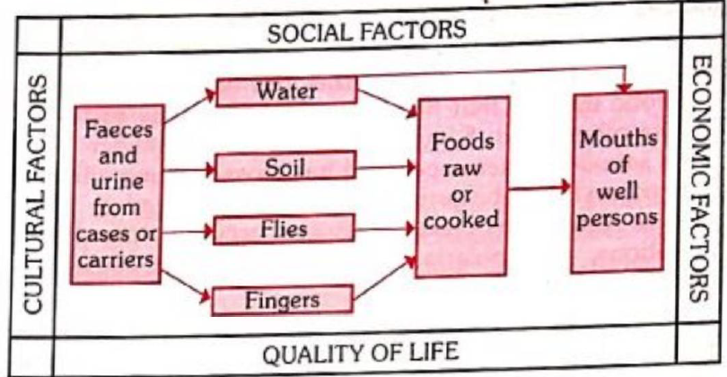
Modes of transmission
Faeco-oral and Urine-oral route
Direct transmission – contaminated hands
Indirect transmission – contaminated foods and water, flies

Slide 9
Incubation period
10 – 14 days
May be as short as 3 days or as long as 3 weeks

Slide 10
Clinical features
Insidious onset (may be abrupt in children with chills and high fever)
Prodromal stage – malaise, headache, cough and sore throat associated with abdominal pain and constipation
Fever – step ladder pattern
After 7 – 10 days, fever reaches plateau and patient looks toxic, (exhausted and often prostrated)
Marked constipation or pea soup diarrhea (khaki green slimy stools)
Marked abdominal distension
There is leukopenia and blood, urine and stool culture is positive for salmonella.
If there are no complications the patients condition improves over 7-10 days.
However, relapse may occur for upto 2 weeks after termination of therapy.

Slide 11
Clinical features
Later
Splenomegaly, abdominal distension and tenderness, relative bradycardia, dicrotic pulse, and occasionally meningismus appear.
The rash (rose spots) commonly appears during the second week of disease.
The individual spot, found principally on the trunk, is a pink papule 2-3 mm in diameter that fades on pressure. It disappears in 3-4 days.

Slide 12
Clinical features - complications
Serious complications occur in up to 10 per cent especially in those who have been ill longer than 2 weeks, and who have not received proper treatment.
Intestinal haemorrhage is manifested by a sudden drop in temperature and signs of shock, followed by dark or fresh blood in the stool.
Intestinal perforation is most likely to occur during the third week.
Less frequent complications are urinary retention, pneumonia, thrombophlebitis, myocarditis, psychosis, cholecystitis, nephritis and osteomyelitis

Slide 13
Fatality rates
Estimates of case-fatality rates of typhoid fever range from 1 per cent to 4 per cent;
Fatality rates in children aged less than 4 years being 10 times higher (4.0%) than in older children (0.4%).
In untreated cases, the fatality rates may rise to 10-20 per cent
With early diagnosis and appropriate treatment, mortality has been reduced to about 1 per cent as compared to about 30 per cent in untreated cases.

Slide 14
Laboratory diagnosis
MICROBIOLOGICAL PROCEDURES : The definitive diagnosis of typhoid fever depends on the isolation of S. typhi from blood, bone marrow and stools.
Blood culture is the mainstay of diagnosis of this disease.
SEROLOGICAL PROCEDURE : Felix-Widal test measures agglutinating antibody levels against O and H antigens.
O antibodies appear on day 6-8 and H antibodies on day 10-12 after the onset of disease.
The test has only moderate sensitivity and specificity. It can be negative in upto 30 per cent of culture -proven cases of typhoid fever.
This may be because of prior antibiotic therapy that has blunted the antibody response.
S. typhi shares 0 and H antigens with other salmonella serotypes and has cross-reacting epitopes with other Enterobacteriacae, and this can lead to false positive results.
Such results may also occur in other clinical conditions, e.g. malaria, typhus, bacteraemia caused by other organisms, and cirrhosis.

Slide 15
Laboratory diagnosis
New Diagnostic test
Typhi Dot – Specific IgM and IgG within 3 hours
Typhi dot-M
IDL Tubex test – IgM09 within few minutes

Slide 16
Control
Control of Reservoir
Control of sanitation
Immunization

Slide 17
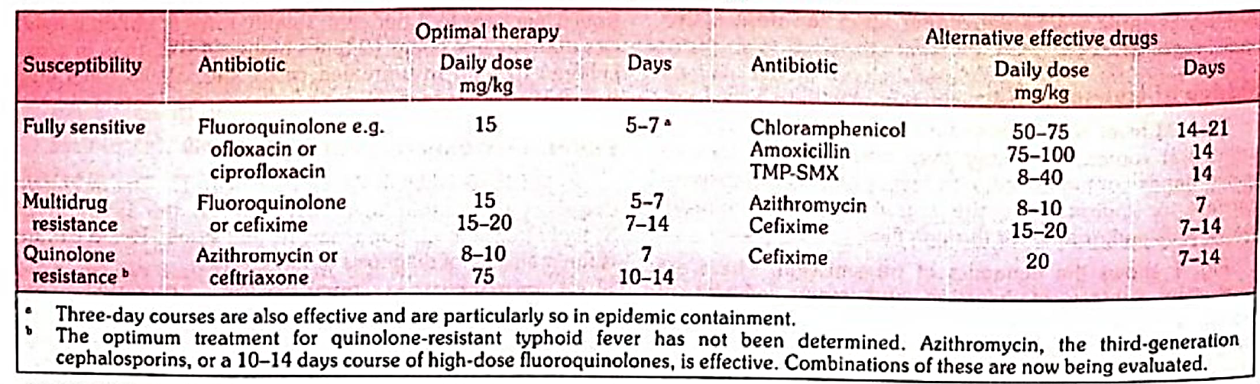
Control of reservoir - Cases
Early diagnosis
Notification
Isolation – till bacteriologically negative stools and urine reports

Slide 18
Control of reservoir - Cases
Complicated cases - injection of hydrocortisone 100 mg daily for 3 to 4 days,
Disinfection - received in closed containers and disinfected with 5 per cent cresol for at least 2 hours.
All soiled clothes and linen should be soaked in a solution of 2 per cent chlorine and steam-sterilized.
Nurses and doctors should not forget to disinfect their hands,
Follow-up examination of stools and urine should be done for S. typhi 3 to 4 months after discharge of the patient, and again after 12 months to prevent the development of the carrier state.

Slide 19
Control of reservoir - Carriers
Identification : Carriers are identified by cultural and serological examinations.
Duodenal drainage establishes the presence of salmonella in the biliary tract in carriers.
The Vi antibodies are present in about 80 per cent of chronic carriers,
Treatment : The carrier should be given an intensive course of ampicillin or amoxycillin (4-6 g a day) together with Probenecid (2 g/day) for 6 weeks. These drugs are concentrated in the bile and may achieve eradication of the carrier state in about 70 per cent of carriers.
(Surgery :
Cholecystectomy with concomitant ampicillin therapy – cure rate may be as high as 80%
Urinary carriers are easy to treat, but refractory cases may need nephrectomy when one kidney is damaged and the other healthy,

Slide 20
Control of reservoir - Carriers
Surveillance – should be prevented from handling foods, milk or water for others
Health education
Washing of hands after defecation or urination and before preparing food is an essential element

Slide 21
Control of Sanitation
Protection and purification of drinking water supplies
Improvement of basic sanitation,
Promotion of food hygiene
Sanitary measures, not followed by health education may produce only temporary results.

Slide 22
Immunization
Immunization against typhoid does not give 100 per cent protection, but it definitely lowers both the incidence and seriousness of the infection.
It can be given at any age upwards of two years (injectable vaccine) and upward of 5 years (oral vaccine).
It is recommended to : (i) those living in endemic areas
(ii) Household contacts
(iii) Groups at risk of infection such as school children and hospital staff
(iv) Travelers proceeding to endemic areas
(v) Attending melas and yatras.

Slide 23
Immunization
Vi polysaccharide
T cell independent IgG response Not boosted by additional doses
IM / SC injection
Recommended storage – 2 – 8 degree Celsius
Protection after 7 days, revaccination every 3 years
Ty21a vaccine
Oral administration
The vaccine is administered every other day; on 1, 3, and 5th day; a 3-dose regimen is recommended. With the 3-dose regimen, protective immunity is achieved 7 days after the last dose.
The recommendation is to repeat this series every 3 years for people living in endemic areas, and every year for individuals travelling; from non-endemic to endemic countries.
Proguanil and antibacterial drugs should be stopped from 3 days before until 3 days after giving Ty21a, as such drugs may harm live bacterial vaccines.
The vaccine is unlikely to be efficacious if administrated at the time of ongoing diarrhoea.

Slide 24
Food Poisoning
 | Staph food poisoning | Salmonella food poisoning | Bacillus cereus (Emetic form) | Bacillus cereus (diarrheal form)
Agent | Staphylococcus aureus – enterotoxin (preformed) | S. typhimurium S. cholerasuis S. enteritidis | Bacillus cereus – enterotoxin (preformed) | Bacillus cereus
Source of infection | Milk and its products | Meat, milk, eggs, and its products, urine and feces of rat, mice, human carrier | Raw foods, processed food, fried rice, mashed potato, pasta | Soup, sauce, meat, gravy, custard
Incubation period | 1 – 6 hours | 12 – 34 hours | 1 – 6 hours | 12 – 24 hours
Clinical features | Vomiting, nausea, stomach cramps, diarrhea | Nausea, low grade fever, headache, vomiting, diarrhea, reactive arthritis (some cases) | Upper GI tract symptom | Lower GI tract symptom
Prevention and treatment | Symptomatic treatment like fluid therapy, anti-emetic Food Safety measure: Prevent contamination of food with specific health education to food handlers Personal hygiene and sanitary improvement

Slide 25
 | Botulism | C. perfringes
Agent | Clostridium botulinum – type A, B or E: exotoxin (preformed) | Clostridium perfringes (C. welchii)
Source of infection | Home preserved foods such as canned vegetables, smoked fish | Ingestion of poultry, meat ( reheated)
Incubation period | 18 – 36 hours | 6 – 24 hours (peak 10 – 14 hours)
Clinical features | Dysphagia, diplopia, ptosis, dysarthria, blurring of vision, muscle weakness, quadriplegia | Diarrhea, abdominal cramp
Complications | Death due to respiratory / cardiac failure | Dehydration
Prevention and treatment | Antitoxin useful in prophylaxis and to reverse neuro-mascular block, Guanidine hydrochloride is useful | Symptomatic treatment Food safety measure

Slide 26
Investigation of food poisoning
Secure complete list of people involved and their history : All the people who have shared part of the food should be interviewed.
They may be supplied questionnaires concerning the
Foods eaten during the previous 2 days
Place of consumption;
Time of onset of symptoms;
Symptoms of illness (e.G., Nausea, vomiting, diarrhoea, abdominal pain, headache, fever, prostration, etc.) In order of occurrence;
Personal data such as age, sex, residence, occupation, and any other helpful information.
Questionnaires may be administered to kitchen employees and those working in the dining halls.

Slide 27
Investigation of food poisoning
Laboratory investigations
The object is not only to incriminate the causative agent from stool, vomit or remnants of food by inoculating into appropriate media
Determine the total number of bacteria and the relative numbers of each kind involved.
Stool samples of the kitchen employees and food handlers should also be investigated.
The samples should be examined aerobically and anaerobically.
Phage typing of the organisms should be done to complete the laboratory investigation,
Animal experiments :
It may be necessary to feed rhesus monkeys with the remnants of food.
Protection tests are useful in the case of botulism; in this, a saline filtrate of food-stuff is injected subcutaneously into mice protected with antitoxic sera, keeping suitable controls.

Slide 28
Investigation of food poisoning
Blood for antibodies : This is useful for retrospective diagnosis,
Environmental study : This includes inspection of the eating place(s), kitchen(s), and questioning of food handlers regarding food preparation,
Data analysis : The data should be analyzed according to the descriptive methods of time, place and person distribution.
Food-specific attack rates should be calculated.
A case control study may be undertaken to establish the epidemiologic association between, illness and the intake of a particular food.

Slide 29
Prevention and control – food sanitation
Meat inspection : The food animals must be free from infection. This can be ensured by their examination by veterinary staff, both before and after slaughter,
Personal hygiene : A high standard of personal hygiene among individuals engaged in the handling, preparation and cooking of food is needed.
Food handlers : Those suffering from infected wounds, boils, diarrhoea, dysentery, throat infection, etc should be excluded from food handling.
The medical inspection of food handlers is required in many countries; this is of limited value in the detection of carriers, although it will remove some sources of infection

Slide 30
Prevention and control – food sanitation
Food handling techniques : The handling of ready-to-eat foods with bare hands should be reduced to a minimum.
Time between preparation and consumption of food should be kept short.
The importance of rapid cooling and cold storage must be stressed.
Milk, milk products and egg products should be pasteurized.
Food must be thoroughly cooked.
The heal must penetrate the centre of the food leaving thereby no cool spots.
Most food poisoning organisms are killed at temperatures over 60 deg. C.
Sanitary improvements : Sanitization of all work surfaces, utensils and equipments must be ensured.
Food premises should be kept free from rats, mice, flies and dust,
Health education : Food handlers should be educated in matters of clean habits and personal hygiene, such as frequent and thorough hand washing.

Slide 31
Prevention and control – refrigeration
In the prevention of bacterial food poisoning, emphasis must be placed on proper temperature control.
Food should not be left in warm pantries; a few germs can multiply to millions by the next morning.
Foods not eaten immediately should be kept in cold storage to prevent bacterial multiplication and toxin production.
“Cook and eat the same day” is a golden rule.
When foods are held between 10 deg. C (50 deg. F) and 49 deg. C (120 deg.F) they are in the danger zone for bacterial growth.
Cold is bacteriostatic at temperature below 4 deg. C (40 deg.F), and refrigeration temperature should not exceed this level.
SURVEILLANCE; Food samples must be obtained from the food establishments periodically and subjected to laboratory analysis if they were unsatisfactory. Continuing surveillance is necessary to avoid outbreaks of food-borne diseases.

